Slide 1

APPLIED MACHINE LEARNING
Name: SAHIL MISHRA
Branch: CEN
SIC. No. : 20BCEC60
SEMESTER: 5TH
Under the guidance of:
DR.BIRANCHI NARAYAN RATH

Slide 2
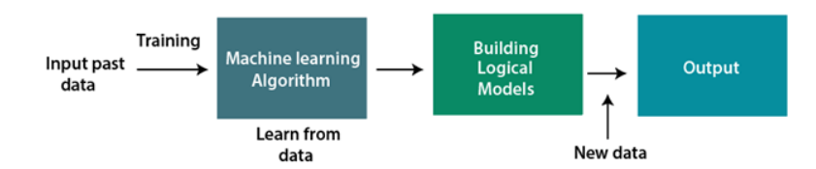
INTRODUCTION
Machine learning in simple words, is to teach machines , like humans so to get more accurate output more conveniently.
ML is one of the most exciting technologies that one would have ever come across. As it is evident from the name, it gives the computer that makes it more similar to humans: The ability to learn. Machine learning is actively being used today, perhaps in many more places than one would expect.
Machine learning uses various algorithms for building mathematical models and making predictions using historical data or information.

Slide 3
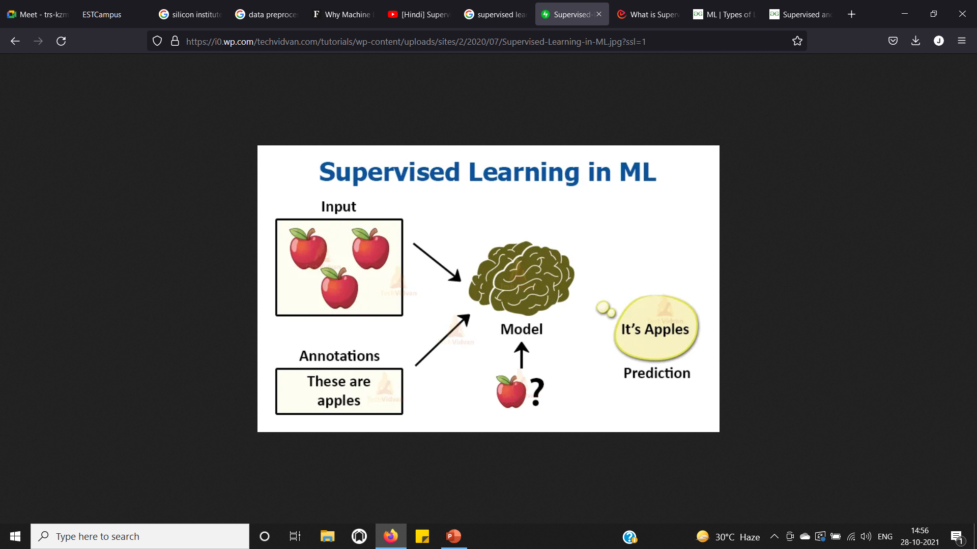
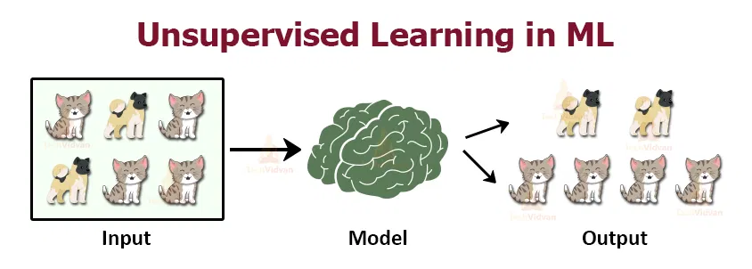
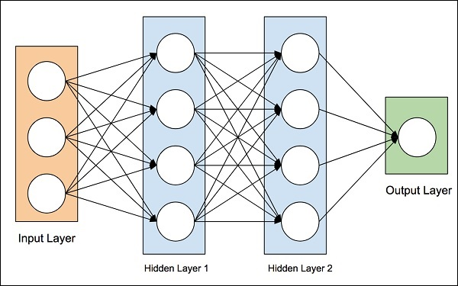
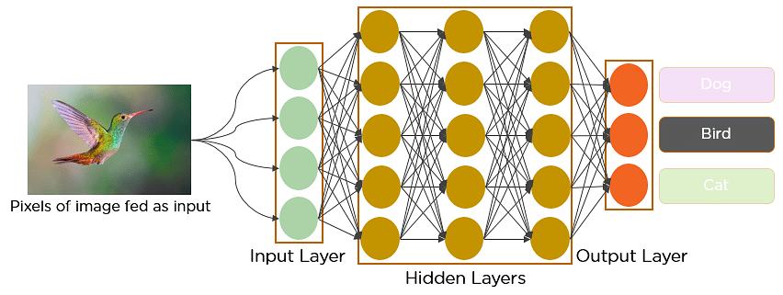
Stages of MACHINE LEARNING
BASIC MACHINE LEARNING ::
SUPERVISED LEARNING : CLASSIFICATION AND REGRESSION
UNSUPERVISED LEARNING : CLUSTERING AND ASSOCIATION
NEURAL NETWORK MODEL ::
ARTIFICIAL NEURAL NETWORK :: A neural network can be understood as a network of hidden layers, an input layer and an output layer that tries to mimic the working of a human brain.
DEEP NEURAL NETWORK MODEL ::
CONVOLUTION NEURAL NETWORK ::
specifically used for image recognition and tasks that involve the processing of pixel data,facial /speech/pattern recognition .
convolution is a mathematical operation on two functions that produces a third function that expresses how the shape of one is modified by the other.

Slide 4
OBJECTIVES
To have brief idea about Machine learning domain.
To have understanding of Data preprocessing.
Import and wrangle data using Python libraries and divide them into training and test datasets.
Implement Linear and Polynomial Regression and classification methods. Interpret Unsupervised learning and learn to use clustering algorithms.
Build Artificial neural network model and Convolution neural network model
In ANN , compile the model ,train the model and performance matrix.
In CNN, build convolution layer ,compile / predict model.
Appreciate the breadth & depth of ML applications and use cases in real-world scenarios.

Slide 5

CONTENTS OF THE PROGRAM
BUILD LINEAR AND MULTILINEAR REGRESSION MODEL .
DETERMINE THE CLASSIFICATION OF MODEL.
IMPLEMENTATION OF LOGISTIC REGRESSION AND NAIVE BAY’S MODEL.
DECISION TREE AND RANDOM FOREST.
IMPLEMENTATION OF K-MEANS CLUSTERING ALGORITHM.
BUILD ANN MODEL AND CNN MODEL AND PREDICT…

Slide 6
METHODOLOGY
Step 1: Define the objective of Problem Statement
Step 2: Data Gathering
Step 3: Data Processing
Step 4: Exploratory Data Analysis
Step 5: Building a Machine Learning Model
Step 6: Building a Neural Network Model
Step 6: Model Evaluation and Optimization
Step 7: Predictions

Slide 7
Projects Done
Title of the project: LEUKOCYTE IMAGE CLASSIFICATION MODEL
Model Used: CONVOLUTION NEURAL NETWORK MODEL
Data collection from: Kaggle.com
Conclusion:
In this project, we covered "Exploratory Data Analysis (EDA)," which discovers errors, locates relevant data, verifies assumptions, and determines the association between explanatory factors. While analyzing data, the usage of EDA is critical. It also demonstrates the usage of a data visualization, outlier elimination, data pre-processing.
Using “CNN model” we designed aLeukocyte Image Classification Model where each image is classified as 4 different Blood Cells. The accuracy of my model is 75%.

Slide 8
CONCLUSION
Finally, when it came to developing our own machine learning models, we looked at the various programming languages, IDEs, and platforms available. The next step is to begin studying and practicing each machine learning method. The subject is broad, which implies that there is breadth, but when we examine depth, each topic may be taught in a few hours. Each topic is distinct from the others. We must explore one topic at a time, learn it, practice it, and build the algorithm/s in it using a language of your choosing. This is the most effective technique to begin studying Machine Learning.
This course assisted us in gaining an understanding of the Machine Learning area and beginning to work on real-world challenges using machine learning techniques.

